Slide 1
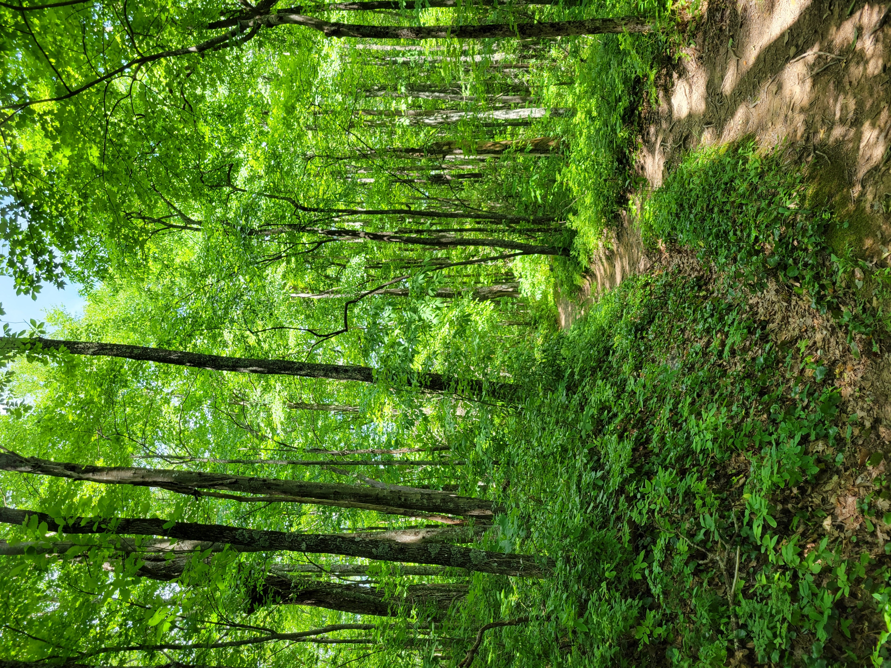





Regulation and modeling nonstructural carbohydrate dynamics
Scott W Oswald, Doug P. Aubrey, Dan M. Ricciuto, Jeff M. Warren
Ecological Society of America, Montréal, QC
August 18, 2022

Slide 2
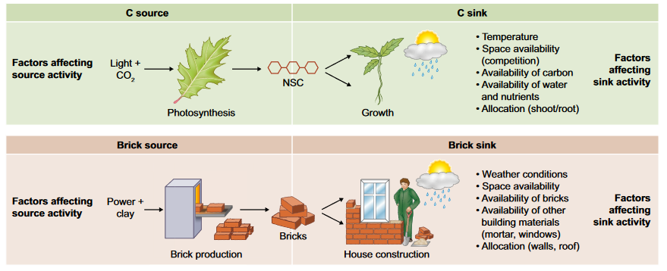
Fig 1. Fatichi et al. 2019
Respiration
Storage
Nonstructural carbohydrates = NSC = sugars + starch

Slide 3
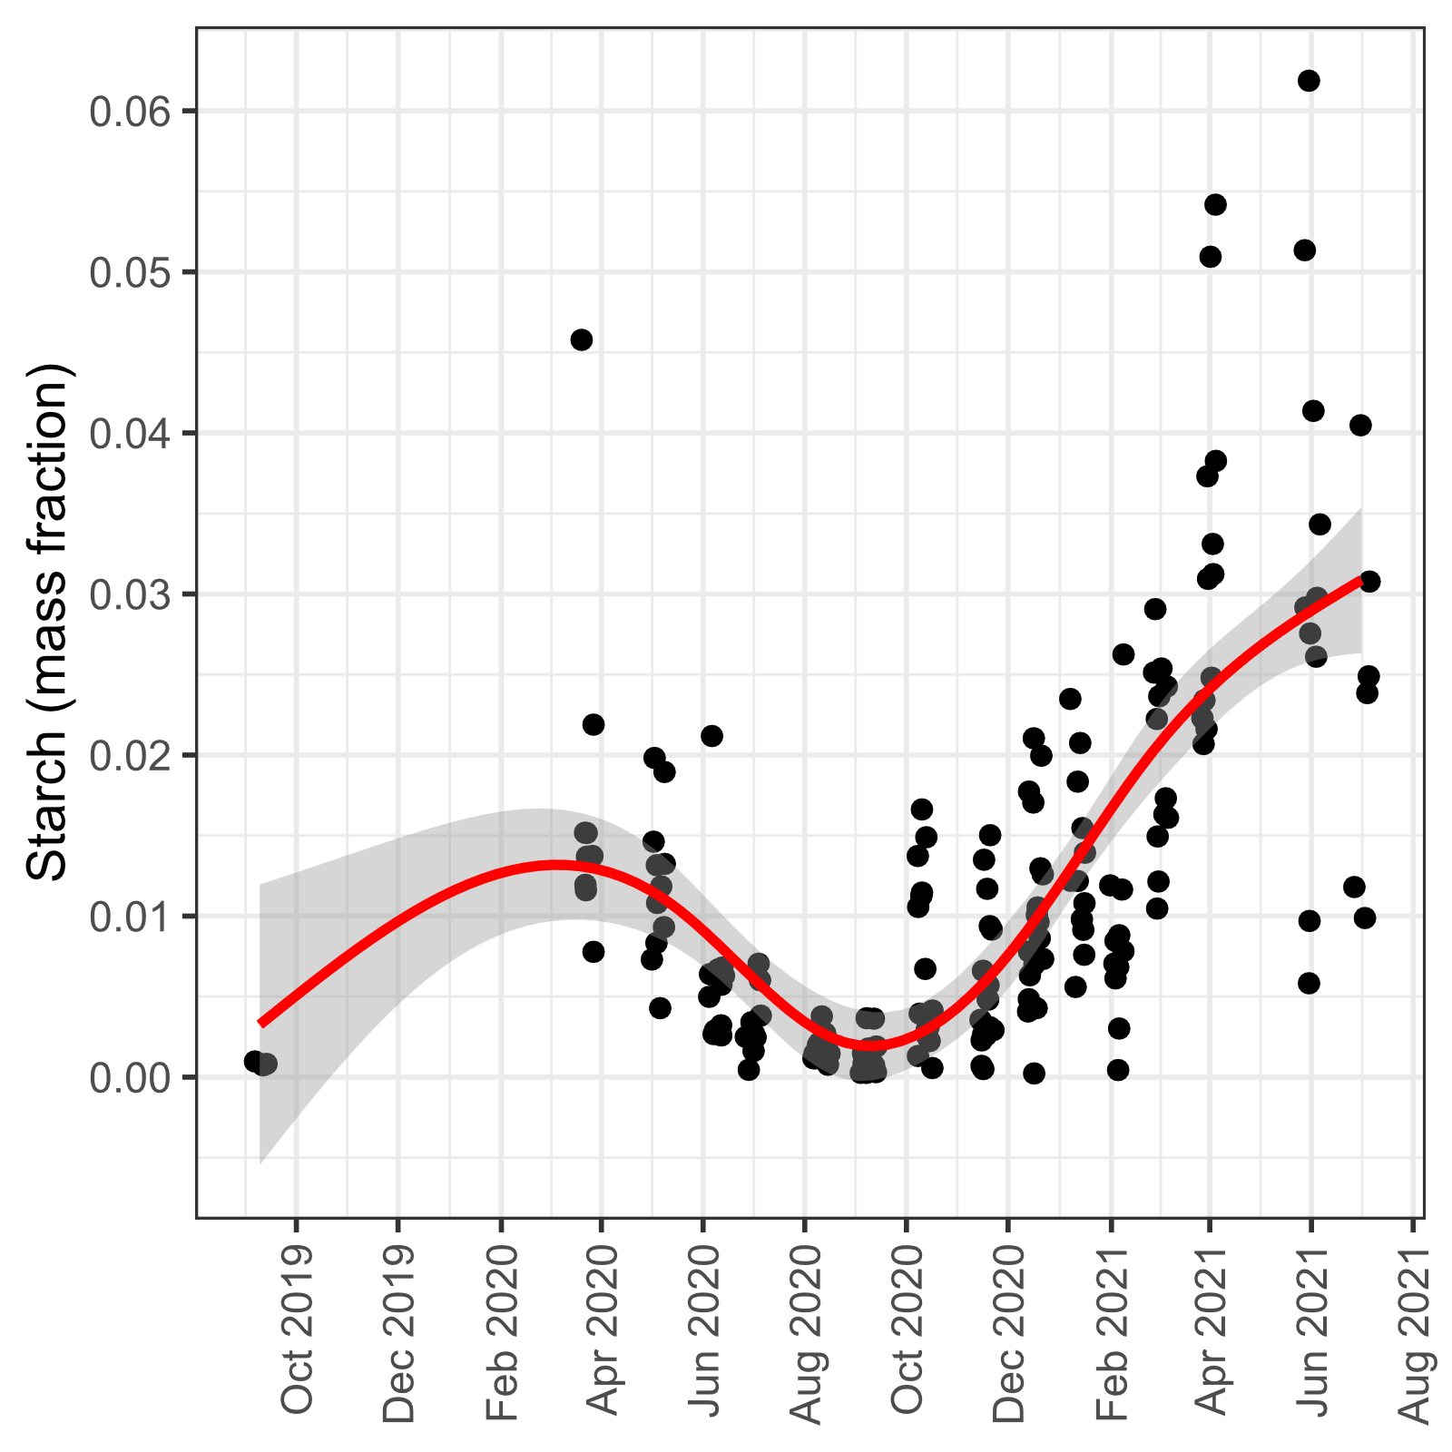
From here to there…
Loblolly Pine Saplings (Pinus taeda)
Respiration
Storage

Slide 4
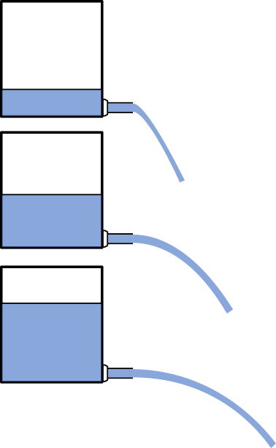
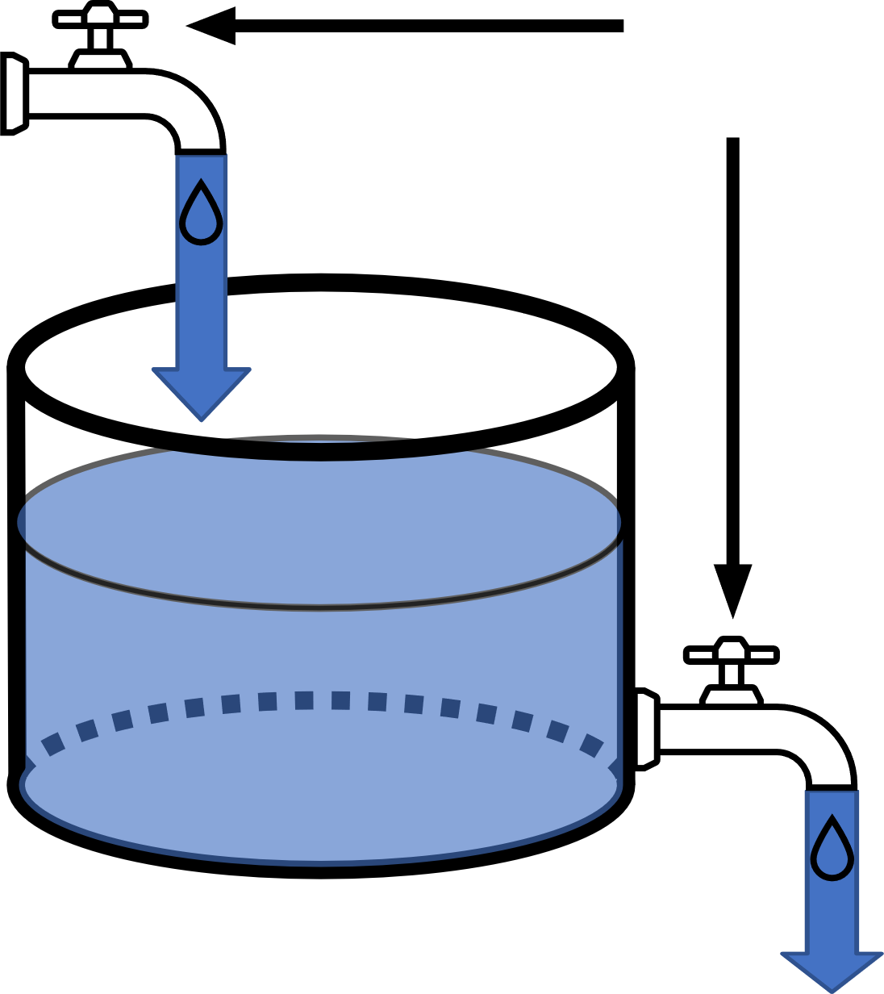
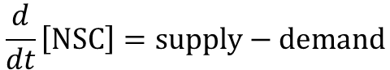
Photosynthesis = NSC supply
Adjustable
NSC
Respiration + Growth = NSC Demand
$$\frac{d}{dt}\left[NSC\right]=supply−demand$$

Slide 5
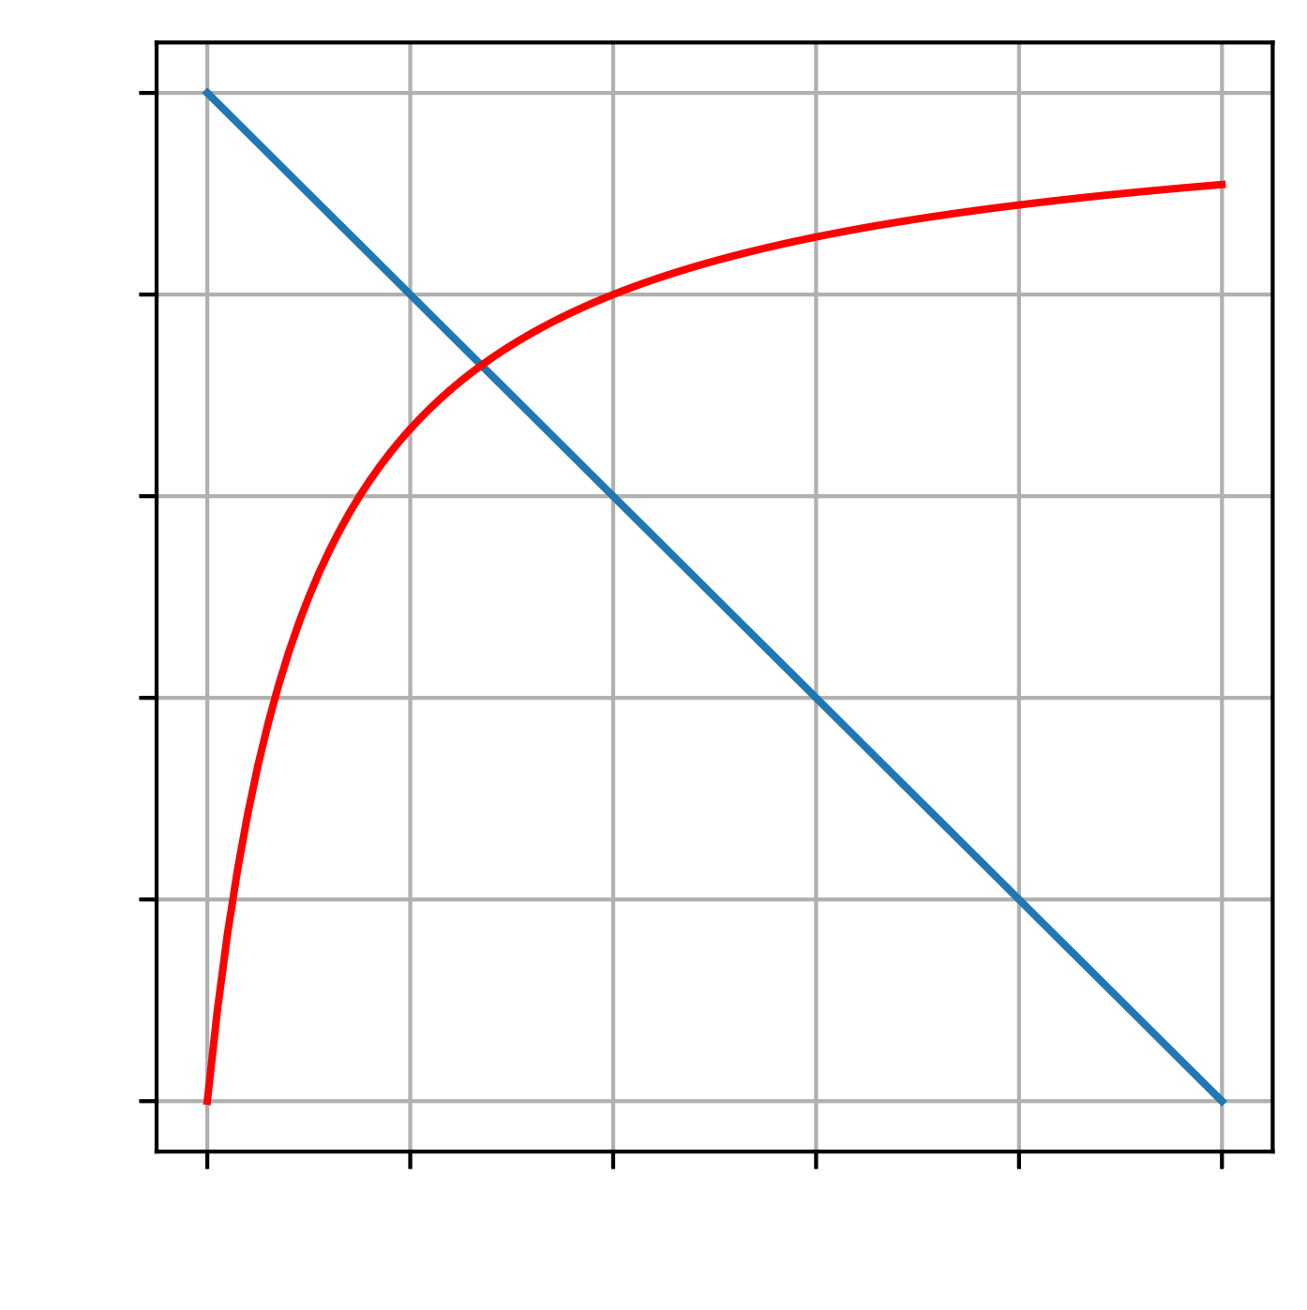
Demand
Rate
Supply
NSC

Slide 6
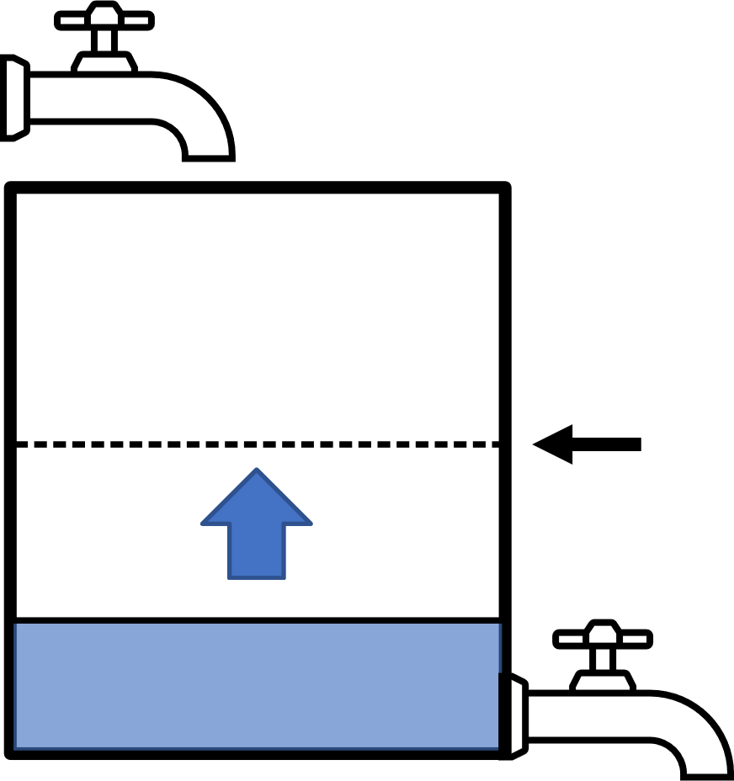
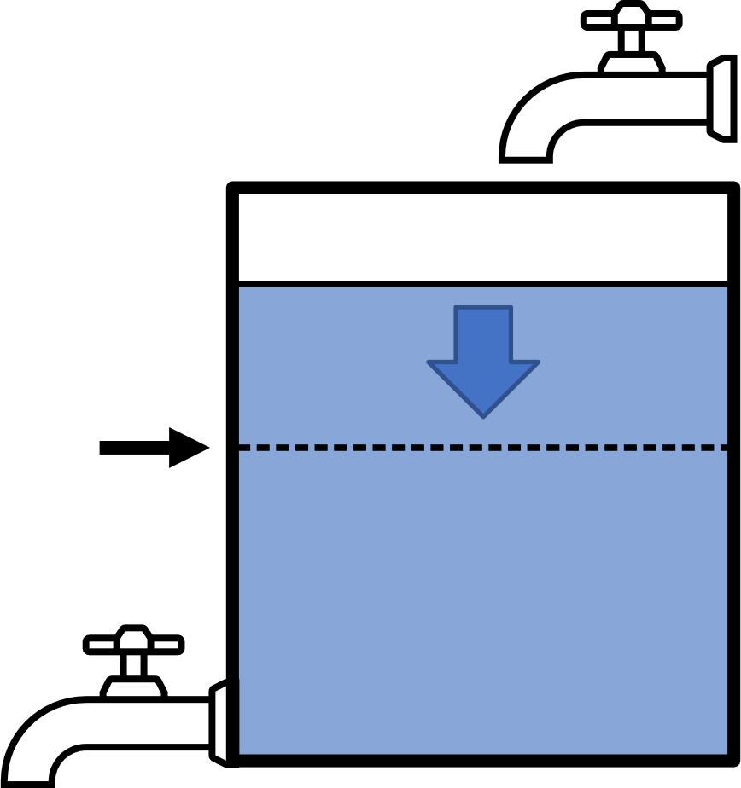
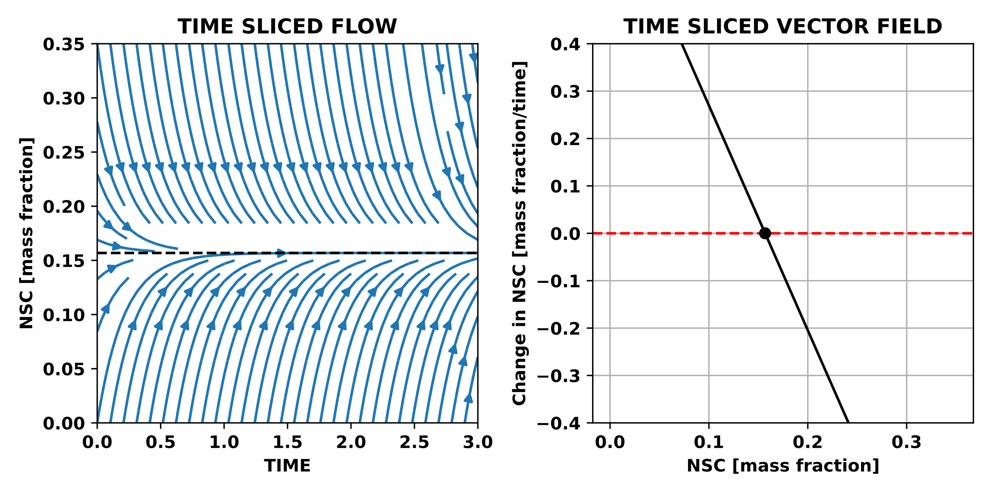
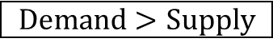

Balance point
Demand
$$Demand>Supply$$
$$Demand>Supply$$
Rate
Supply
Balance point
NSC

Slide 7
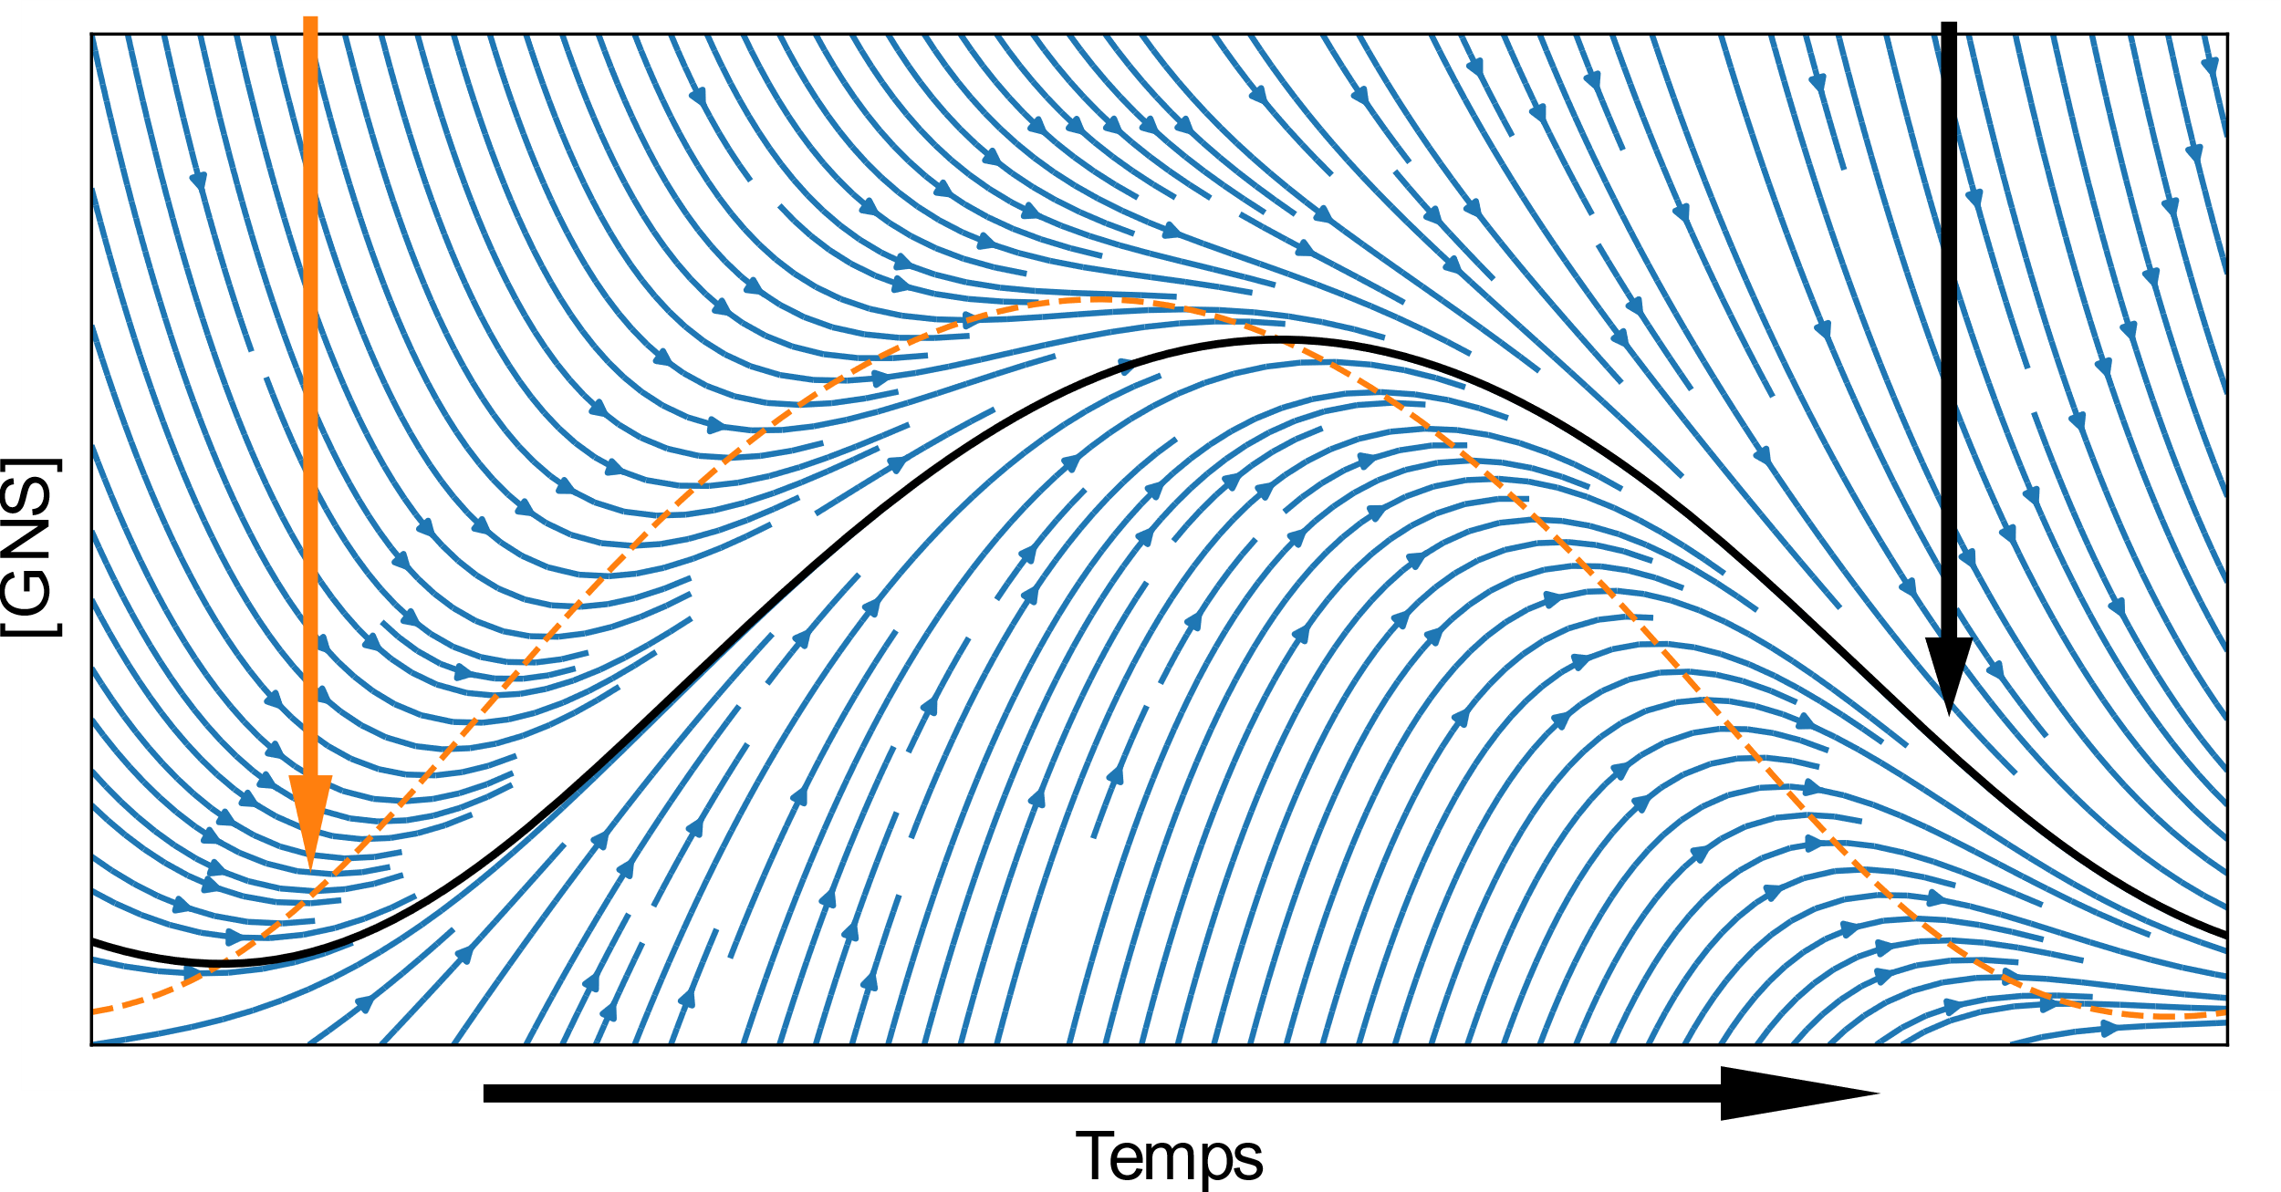
Balance point
Attractor
[NSC]
Time

Slide 8
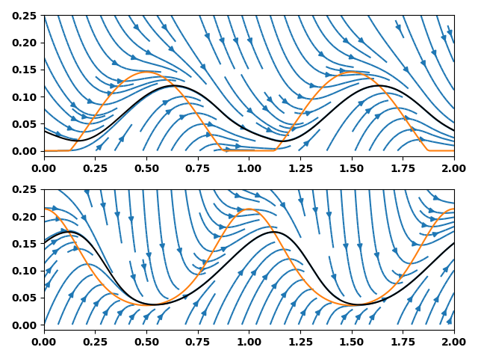
Balance point
Attractor
NSC (mass fraction)
Environment only affects supply
Environment only affects demand
Time (y)

Slide 9
Balance point
Attractor
Environment only affects supply
NSC (mass fraction)
Environment only affects demand
Time (y)

Slide 10
Mature Turkey Oak
(Quercus laevis)
Loblolly Pine Saplings (Pinus taeda)
Mature Longleaf Pine (Pinus palustris)

Slide 11
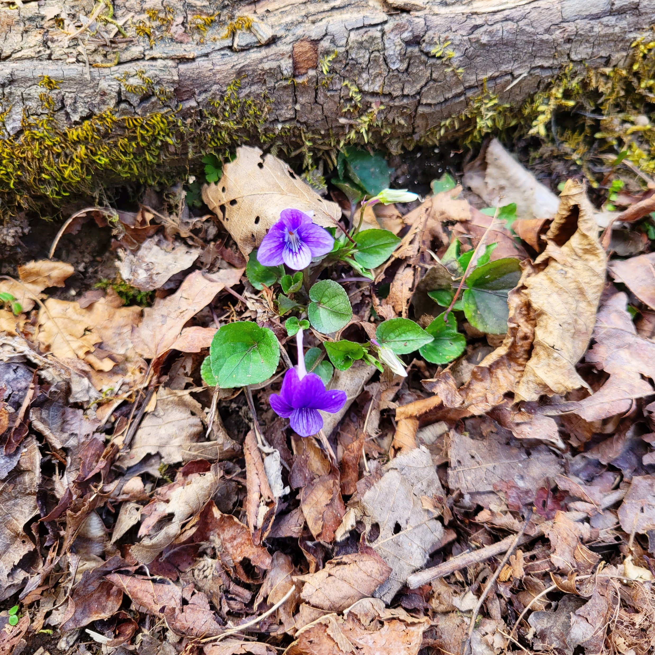
Summary
Photosynthesis = NSC supply
Adjustable
Demand
Questions? Comments? Hiring? Vous engagez?
Rate
leaves.and.lemmas@gmail.com
Supply
NSC
NSC
Respiration + Growth = NSC Demand

Slide 12
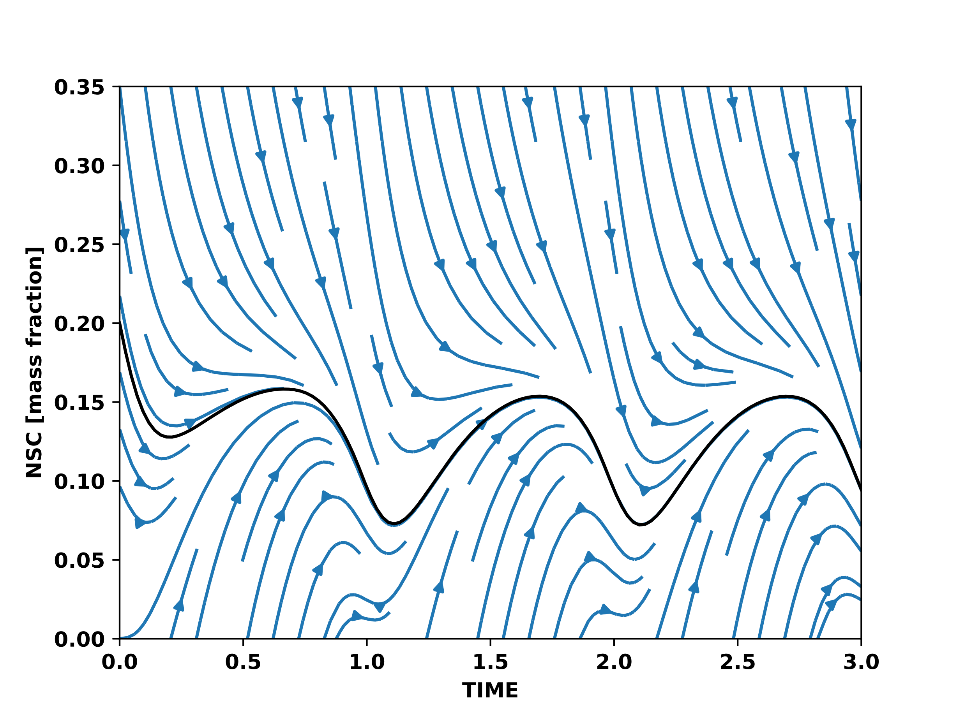
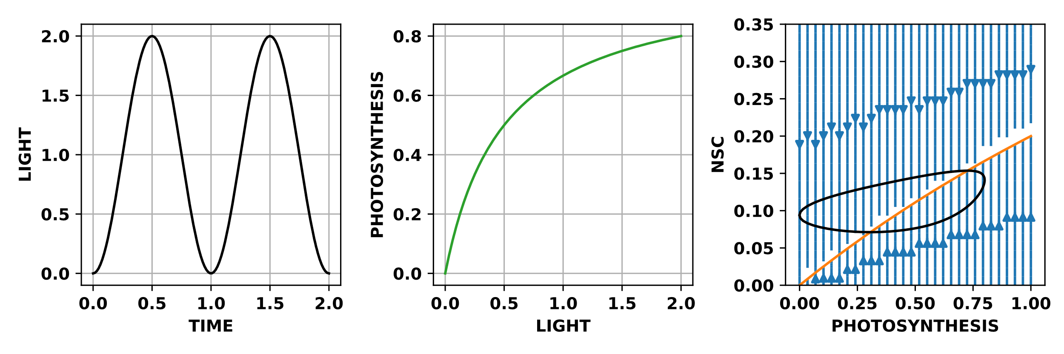
Stable for all environments

Slide 13
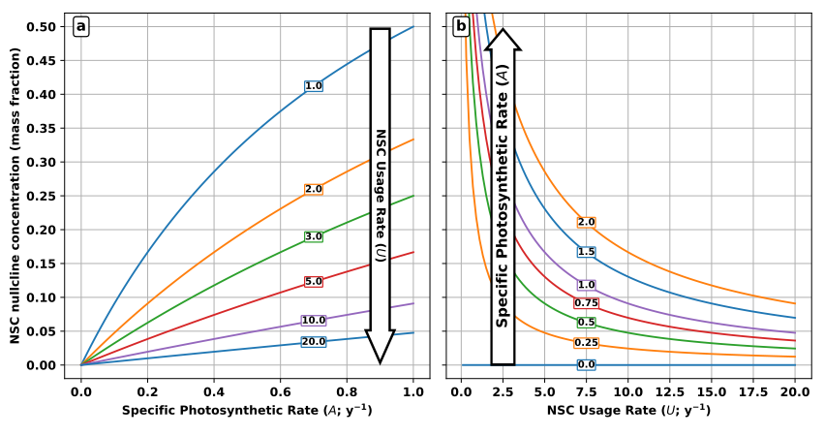
NSC balance point (mass fraction)

Slide 14
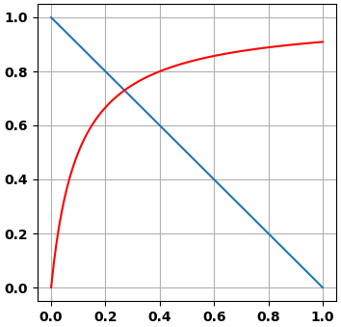
Photosynthesis
Adjustable
Rate
NSC
Respiration + Growth
NSC

Slide 15
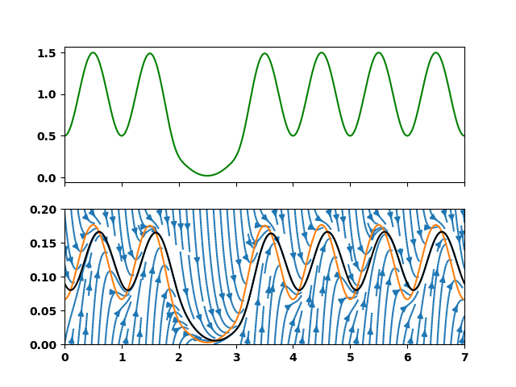
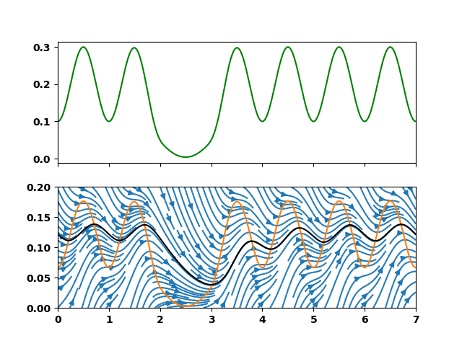
Supply rate
NSC (mass fraction)
Slower rate of supply and demand

Slide 16
NSC balance point (mass fraction)

Slide 17
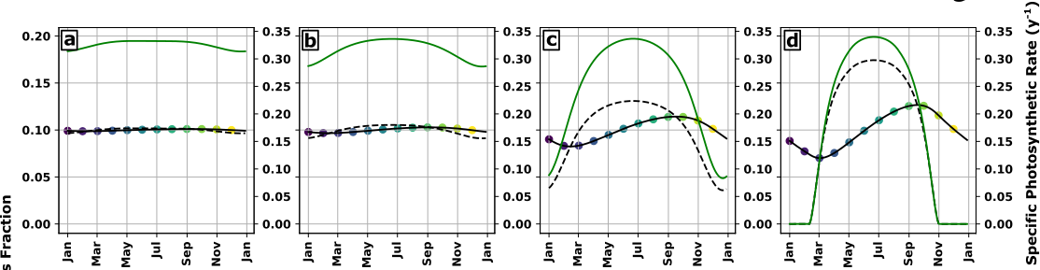
NSC (mass fraction)
Increasing seasonal amplitude of NSC supply

Slide 18
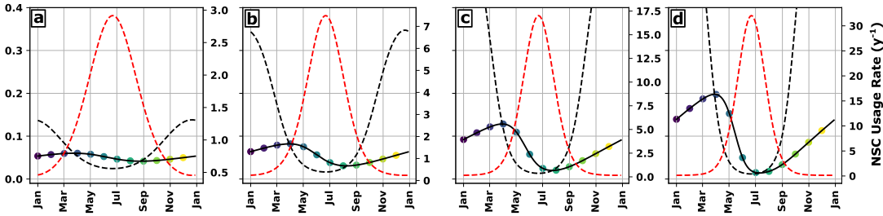
NSC (mass fraction)
Increasing seasonal amplitude of NSC demand

Slide 19
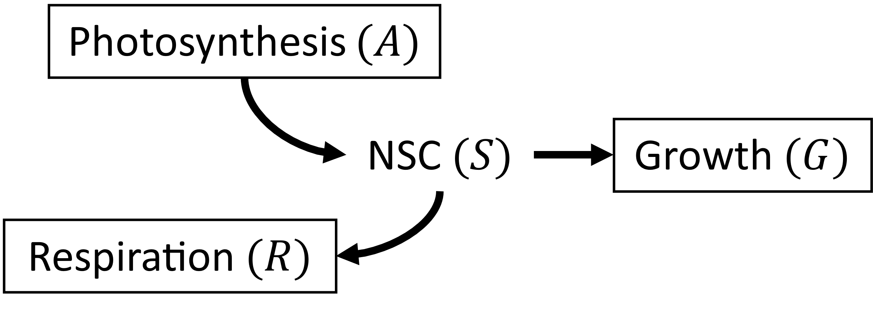
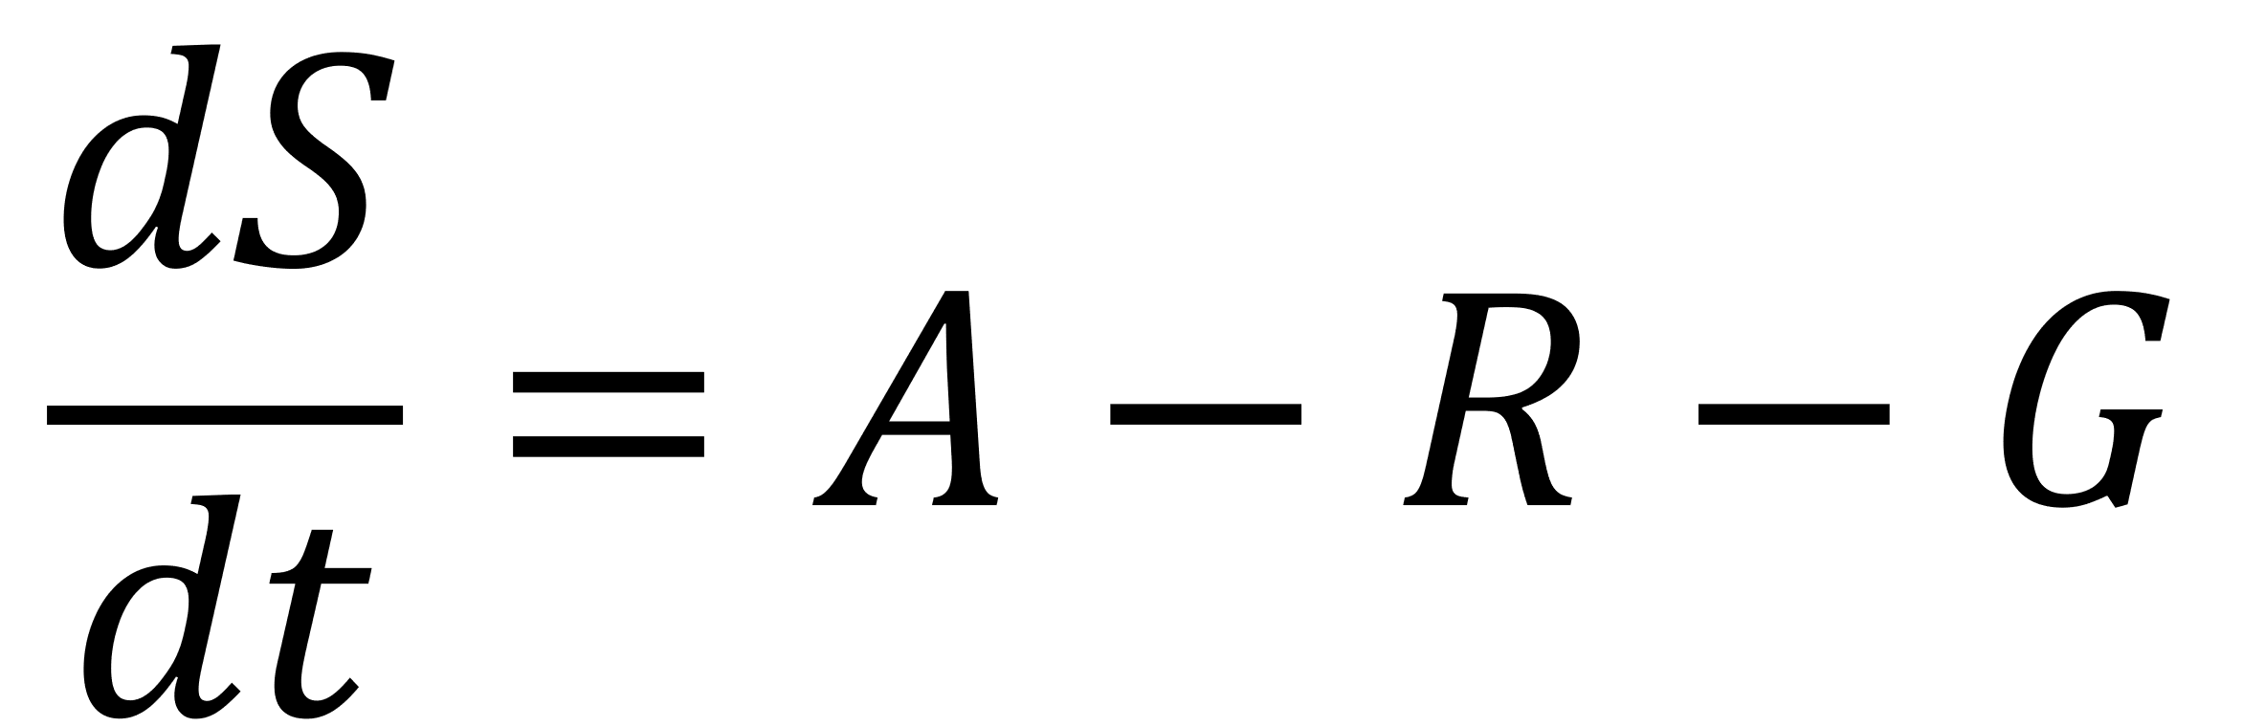
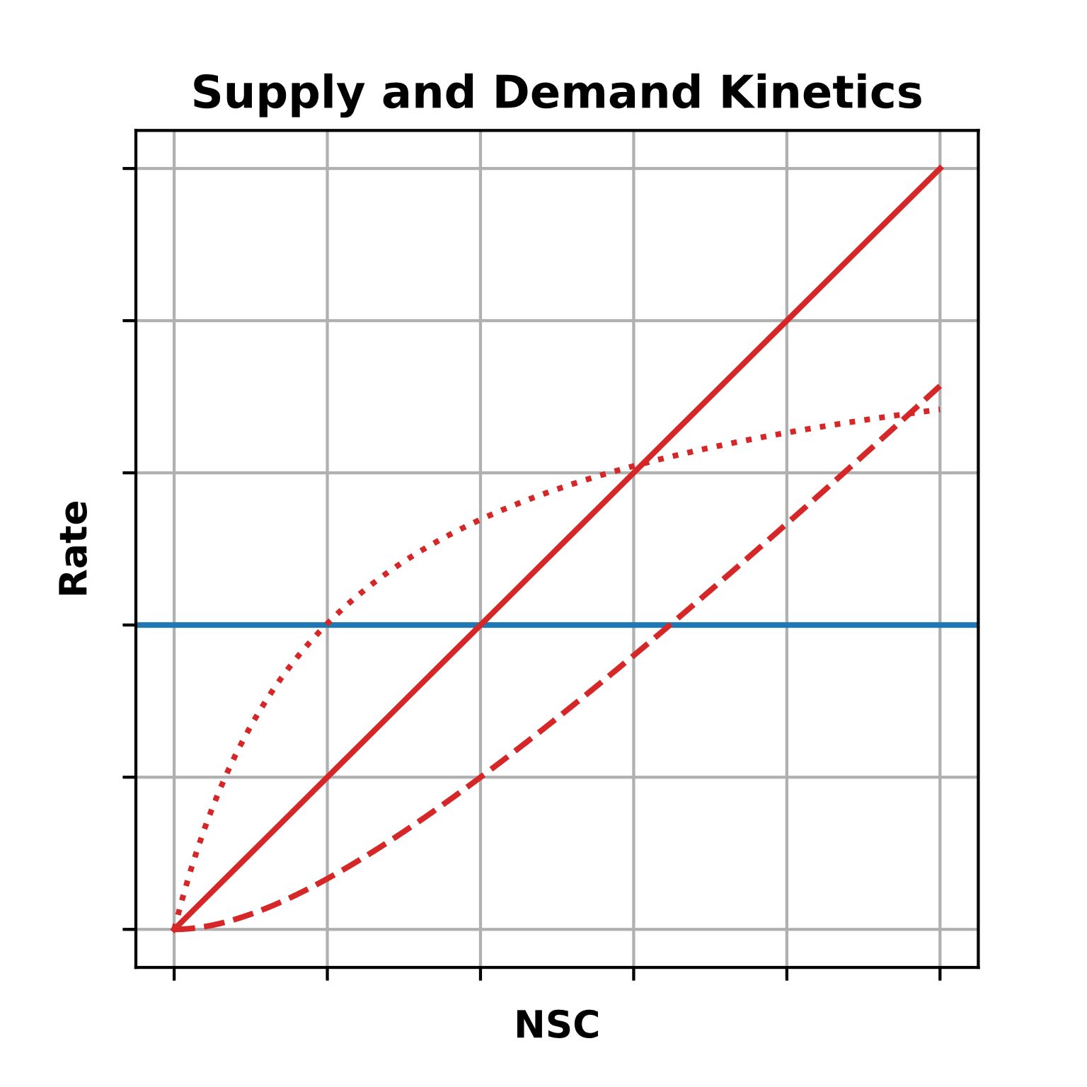

Slide 20
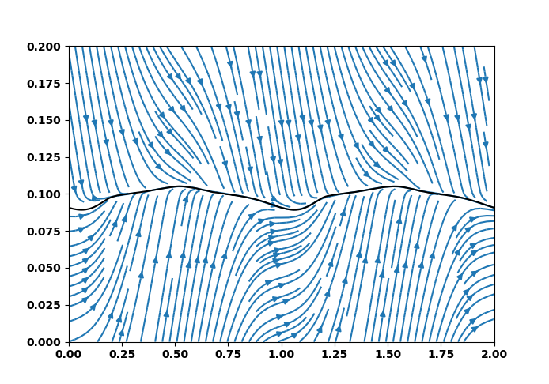
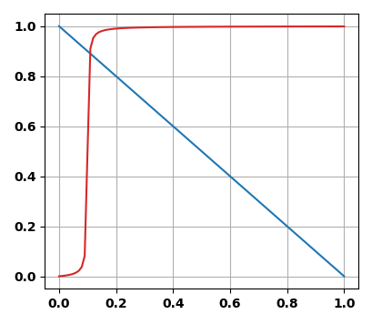
Homeostatic dynamics
Demand Rate
Supply Rate
NSC (mass fraction)
Time (y)

Slide 21
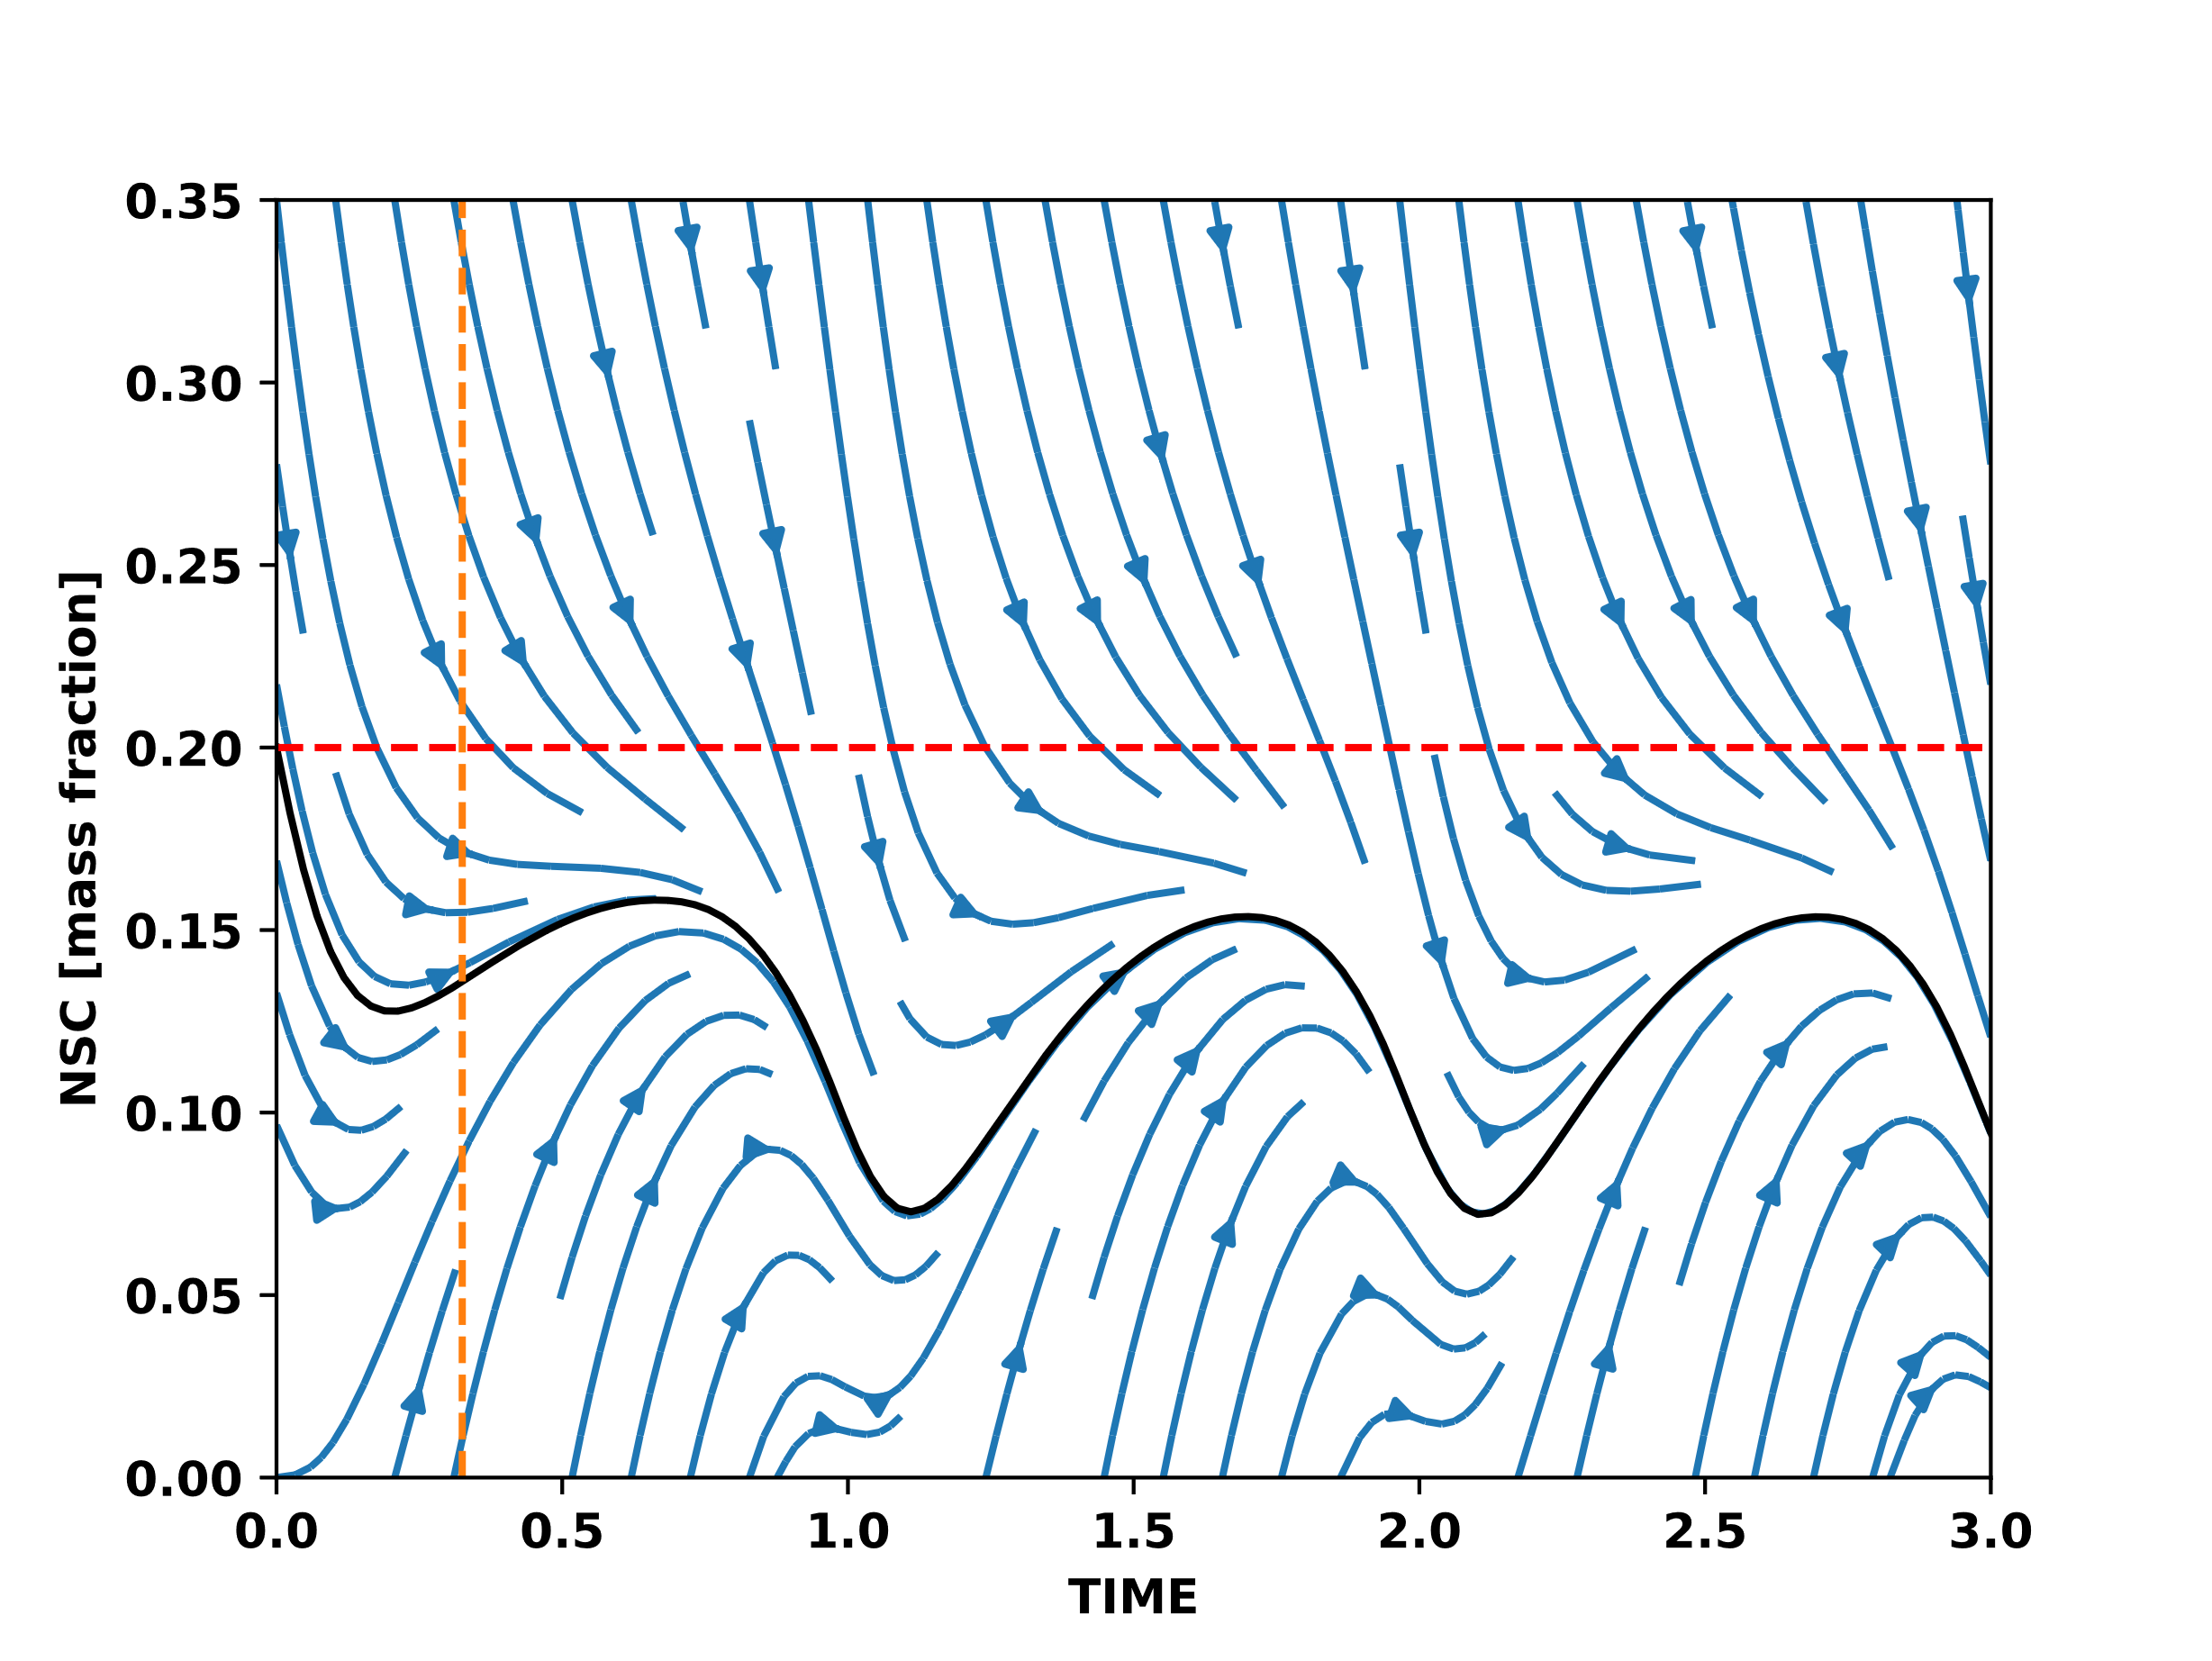
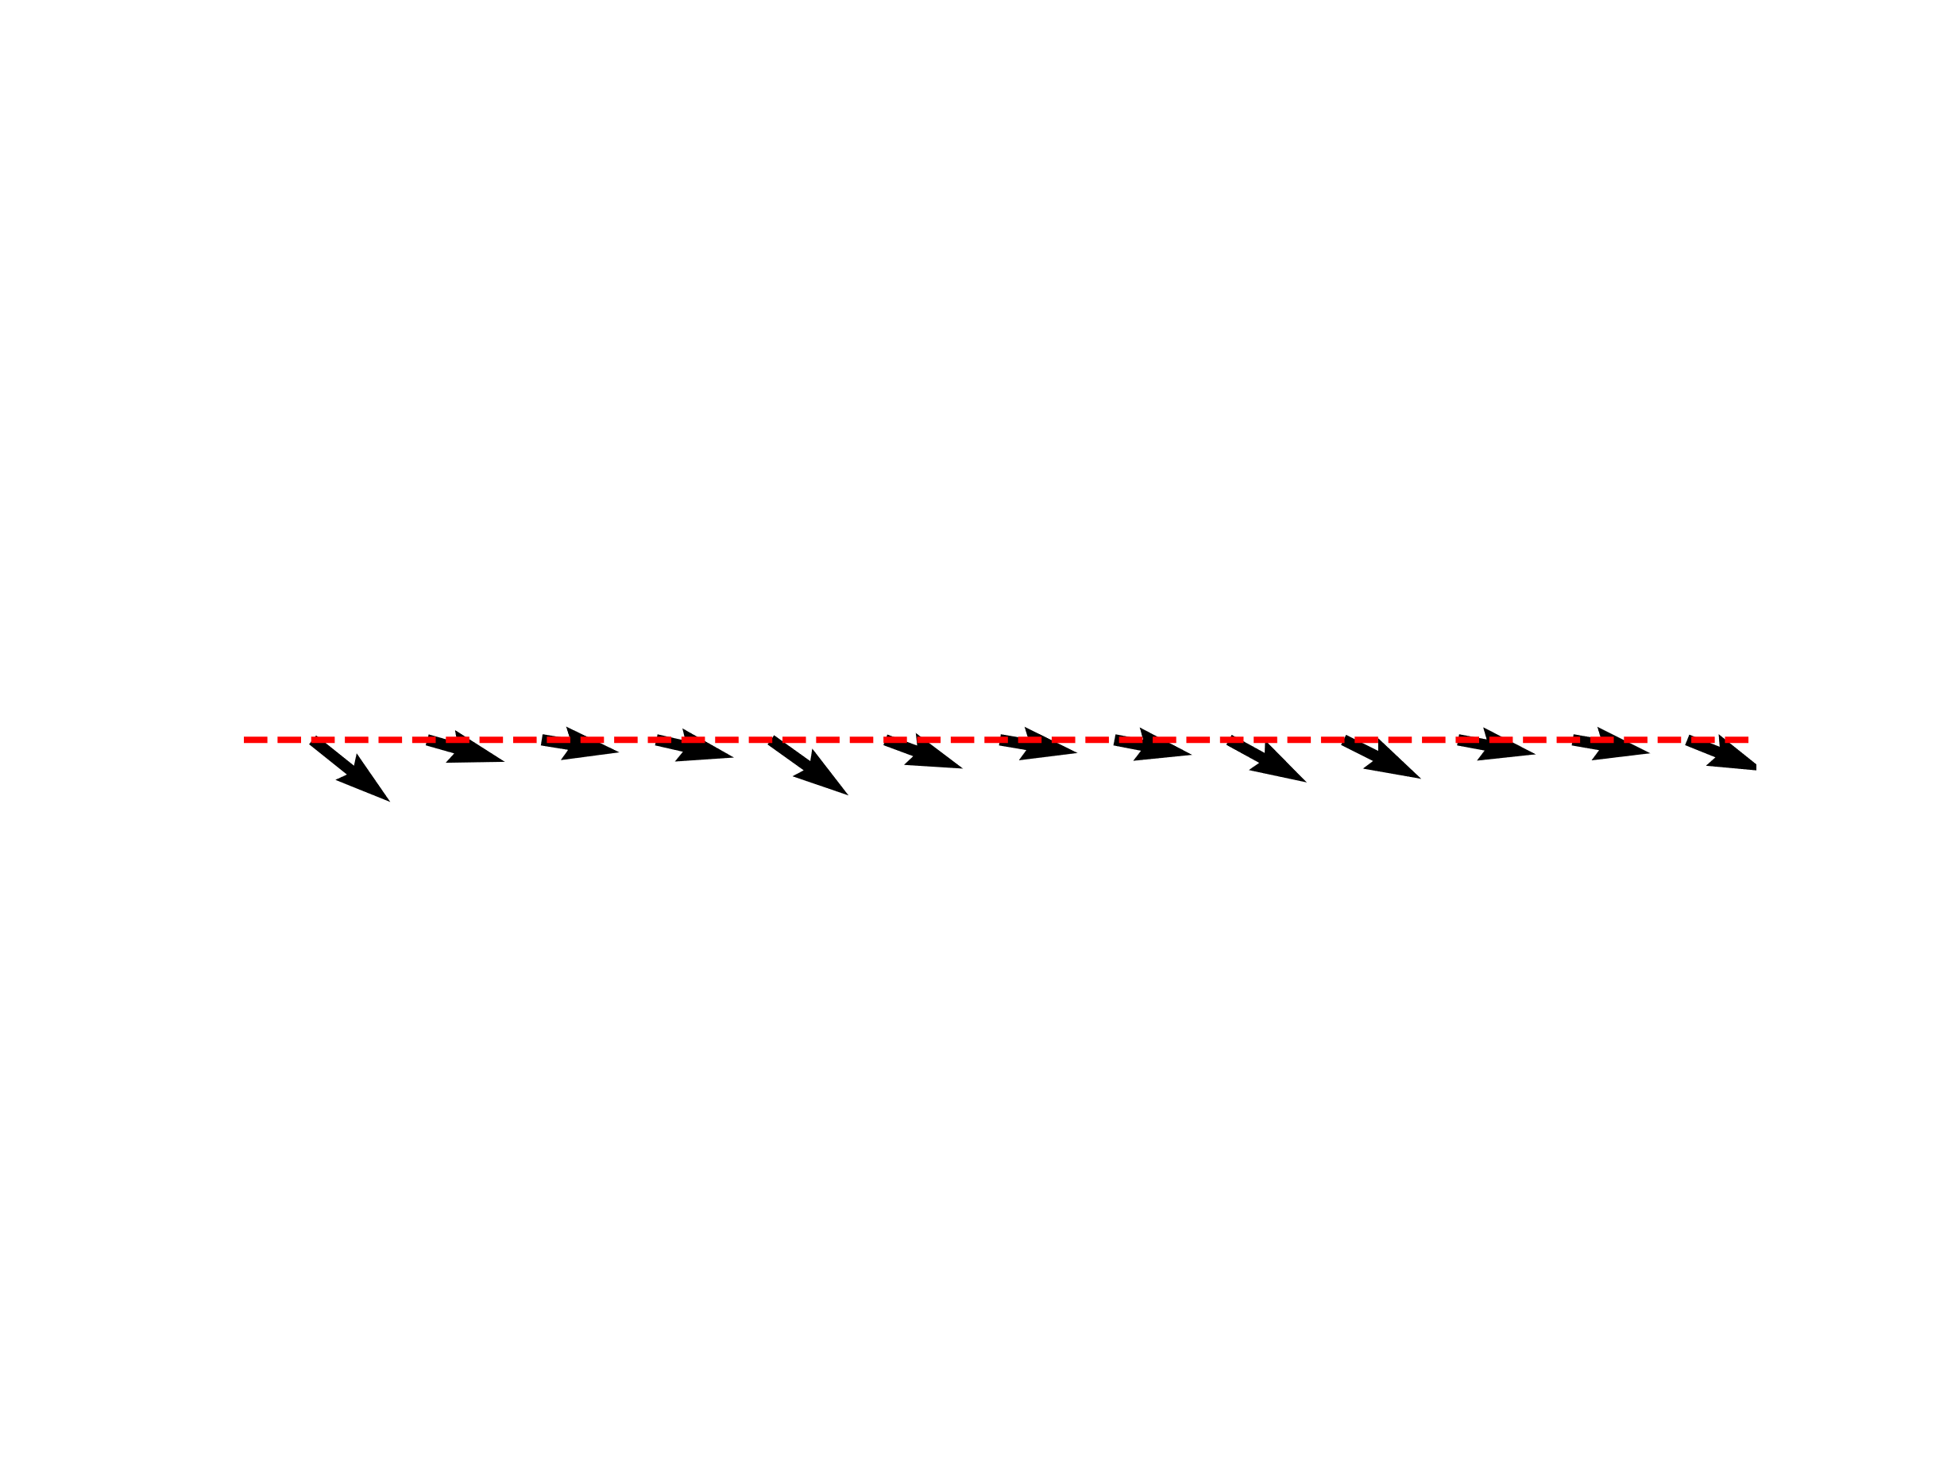
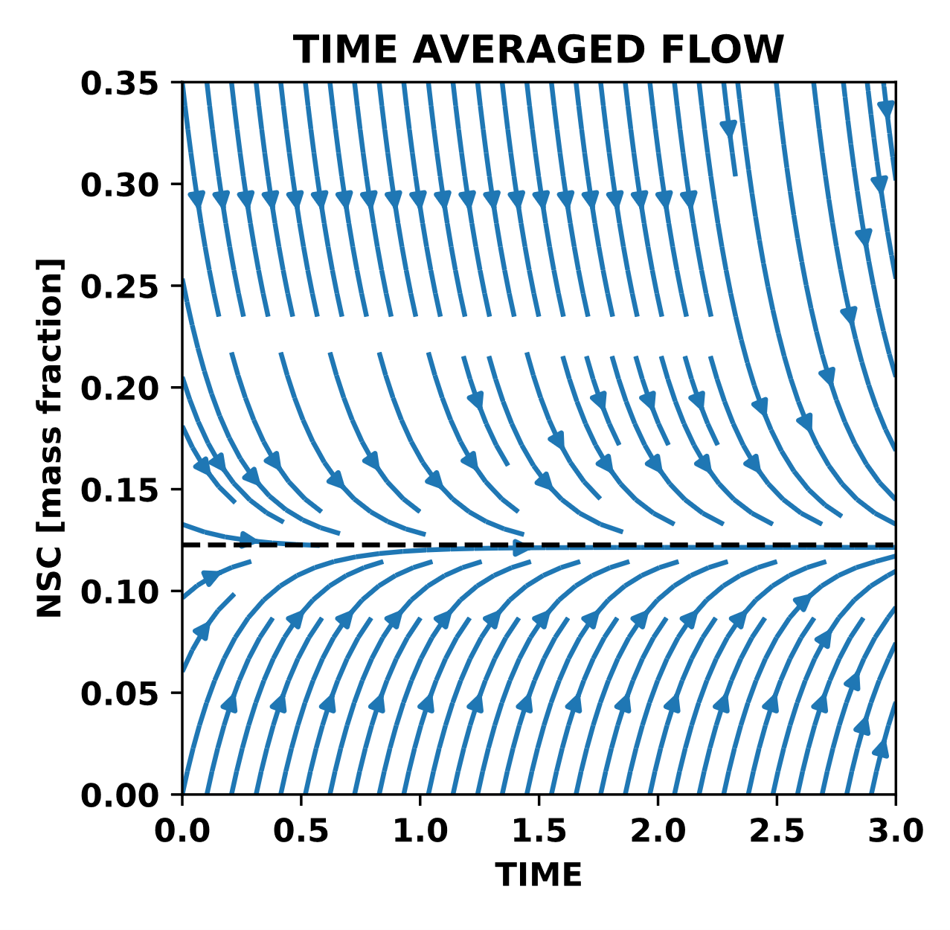

Slide 22
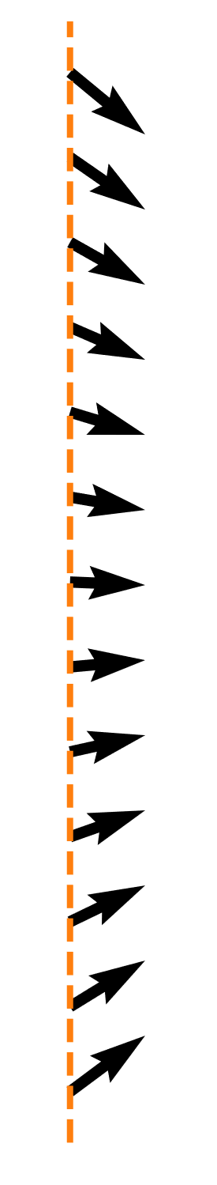

Slide 23
